Slide 1
Creative Spark
Higher Education Enterprise Programme
Creativity Warm-Up for Createathon
www.britishcouncil.org

Slide 2
Circles challenge: Kick start your creativity!

Slide 3


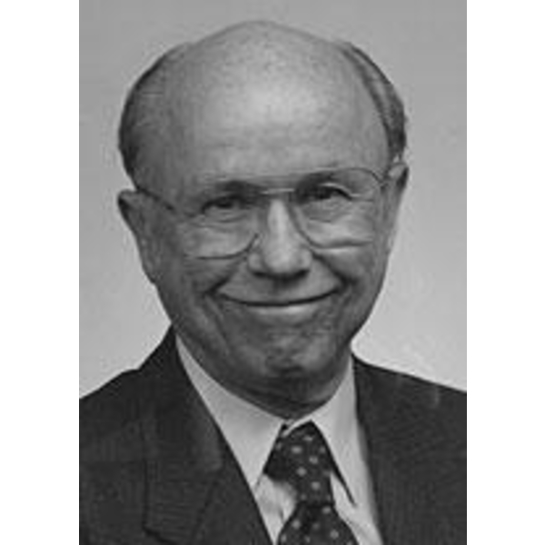

Some games…by Bob McKim
30 circles game:
Adapt as many of those circles as you can into objects…in 3 minutes.
The aim is quantity here!

Slide 4
Ideation
When you generate ideas, you are balancing two goals:
Fluency (the speed and quantity of ideas)
Flexibility (ideas that are truly different and distinct)

Slide 5

Compare results
How many people filled in ten, fifteen, twenty or more circles?
Derivative
Combined circles
or
or
Distinct
Separate
Notes:
“Compare results. Look for the quantity or fluency of ideas. How many people filled in ten, fifteen, twenty or more circles? (Typically most people don’t finish.)
Next, look for diversity or flexibility in ideas. See if the ideas are derivative (a basketball, a baseball, a volleyball) or distinct (a planet, a cookie, a happy face).
Did anyone “break the rules” and combine circles (a snowman or a traffic light)? Were the rules explicit, or just assumed?”
Tom Kelly
IDEO Partner
https://www.ideo.com/blog/build-your-creative-confidence-thirty-circles-exercise (April 2021)

Slide 6
Innovation… (you have got this)
“Ideas successfully applied” - Henry Mintzberg
Make other people say: ‘This is so obvious, why haven’t I ever though of that?’
a new product or service design,
a new production process,
a new approach to marketing or a new way of training and organising
Notes:
“Ideas successfully applied” - Henry Mintzberg
According to Peter Drucker (1985) the best award any innovation can get, is to make other people say:
‘this is so obvious, why haven’t I ever though of that’.
Innovation includes not only new technologies but also new methods or ways of doing things that sometimes appear quite ordinary.
Innovation can be expressed as:
a new product or service design,
a new production process,
a new approach to marketing or a
new way of training and organising.

Slide 7


Plan a Party!
Any kind of party you want.
One rule: respond only with “Yes, And….”
~
Now, plan a different party.
Express concerns with “Yes, but ...”
(You may also have some “yes, and’s,” but be sure to use some “Yes, but’s.”)
Plan a party activity - Source: Susan Robertson Consulting
Susan@SusanRobertsonConsulting.com
Notes:
Plan a party activity - Source: Susan Robertson Consulting
Susan@SusanRobertsonConsulting.com

Slide 8

Debrief: How did that work?
“Yes, and…” was:
Fun
Easy to build
Everyone comfortable to participate
Idea grows
Efficient
Productive in the sense of having a plan
No controls
Source: Susan Robertson Consulting

Slide 9

Debrief: How did that work?
Now, “Yes, but…” was:
Boring party
Less fun
Constrains ideas
People shut down
Retaliation
Less efficient and less productive
More practical ideas
Forces problem solving (for some)
Source: Susan Robertson Consulting

Slide 10

Best of Both
Replace
“YES, BUT…”
with
PPCO response
Source: Susan Robertson Consulting

Slide 11
PPCO
Pluses
Concerns
What do you like about it as it is now?
What’s good?
What’s useful?
What’s valuable?
What’s the potential?
Express concerns as open-ended questions.
How to…?
How might we….?
In what ways might we…?
Potentials
Overcome
What other opportunities might this open up?
Sort of like extra credit.
What problems might it help solve?
What else might it enable?
Potential spin-offs for future growth?
Start with “It might….”
Ideas to solve the most important issues.
Generate solutions to those obstacles
One at a time in order of their importance

